Slide 1
Maggie’s is an extraordinary place to work
Recruitment Pack 2019
“As soon as I entered it was a different world, a calm world. From that day on I felt an affinity with the place.” Gordon, Maggie’s Dundee
Everyone who joins Maggie’s helps people as they experience life-changing events
We are an independent charity working in partnership with the NHS, offering a free programme of support for people with cancer, their families and friends that has been shown to strengthen physical and emotional wellbeing.
Our centres are warm, welcoming places to find practical advice and to speak with experts about the physical and emotional impact of cancer.
"Every day, visitors to our centre tell us how important Maggie’s support is to them as they go through their cancer diagnosis and treatment. It’s so rewarding to work in such a fabulous building and to be able to offer people the time and space they need to talk or simply to relax and gather their thoughts." Mary, Cancer Support Specialist

Slide 2
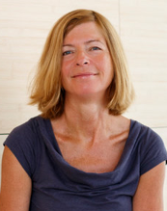
Careers at Maggie’s
People with cancer face tough questions, exhausting treatment and difficult emotions. These challenges affect their family and friends too.
Find out how your skills and commitment can help us to provide Maggie’s programme of support for more people across the UK.
browse current vacancies on our website maggiescentres.org/work-for-us
Chief Executive
Business Development
Finance
Chief Operating Officer
Fundraising
Communications
New Centre Development
Finance
Programme of support
Centre Fundraising
PR & Media
"We have ambitious plans to continue the growth we’ve created in the past twenty two years and to do that we need dedicated professionals who share our vision."
Laura Lee, CEO
International
Staff and Resources
Campaigns
Social Media
NHS & related partnerships
Property and Culture
Trusts
Public affairs
IT
Corporate Partnerships
Communications
Events and Products
Regular Giving
"We’re lucky to work with colleagues throughout the organisation; building relationships the length and breadth of the country.
It’s amazing to find out about the great work everyone is doing in our centres and what our supporters are doing to raise vital funds for Maggie’s.“ Jill, Supporter Care Team
Donor Support Services

Slide 3
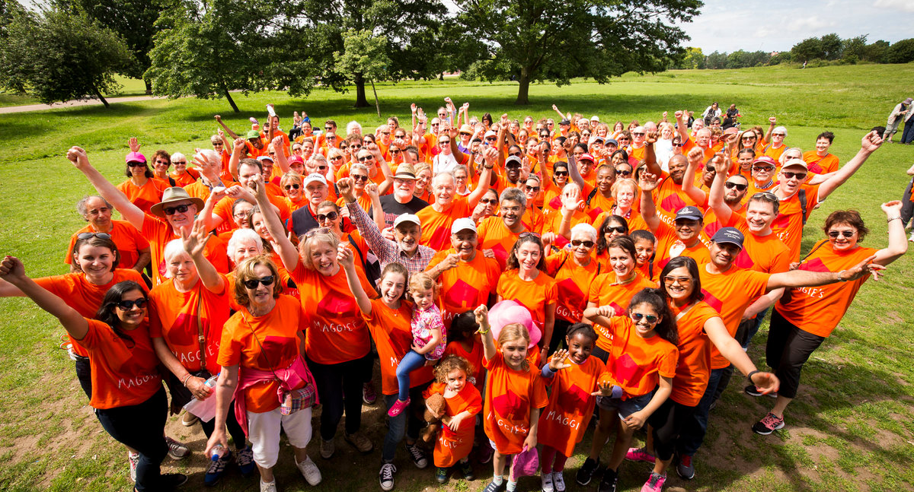
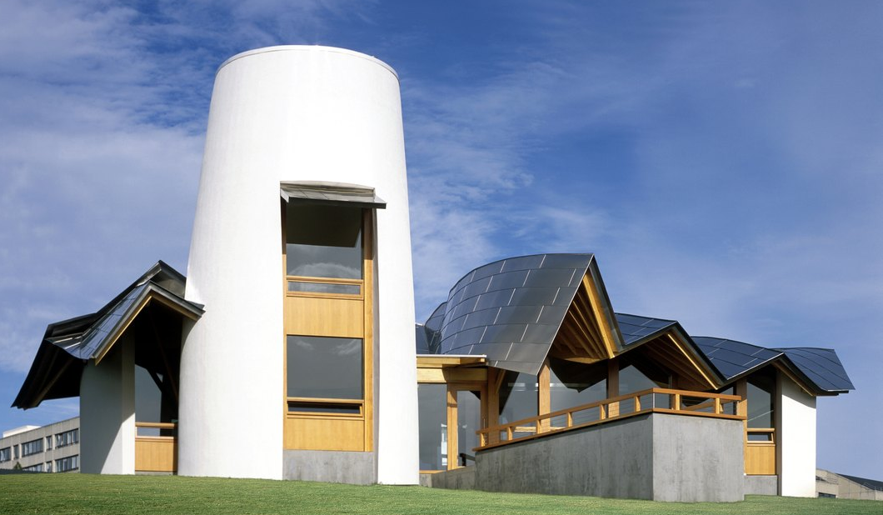
A rewarding career plus a range of benefits:
"The induction week was so valuable and I really felt that Maggie’s had invested in me as a new member of staff." Lauren, Finance Officer
Competitive holiday entitlement
Workplace pension and free financial advice from our affiliated Independent Financial Advisor
Option to apply to continue an existing NHS pension
Sick pay scheme and Death in Service cover
Travel and cycle loans
Eye test expenses
Unique induction week in one of our centres where you will discover how Maggie’s model of support transforms the way that people live with cancer
Our Buddy system offers all new staff a friendly support for their first two months in post
Tailored orientation plan to help you really understand our employee values of caring, sharing, daring
Training and development opportunities
Superb working spaces in a creative environment

Slide 4
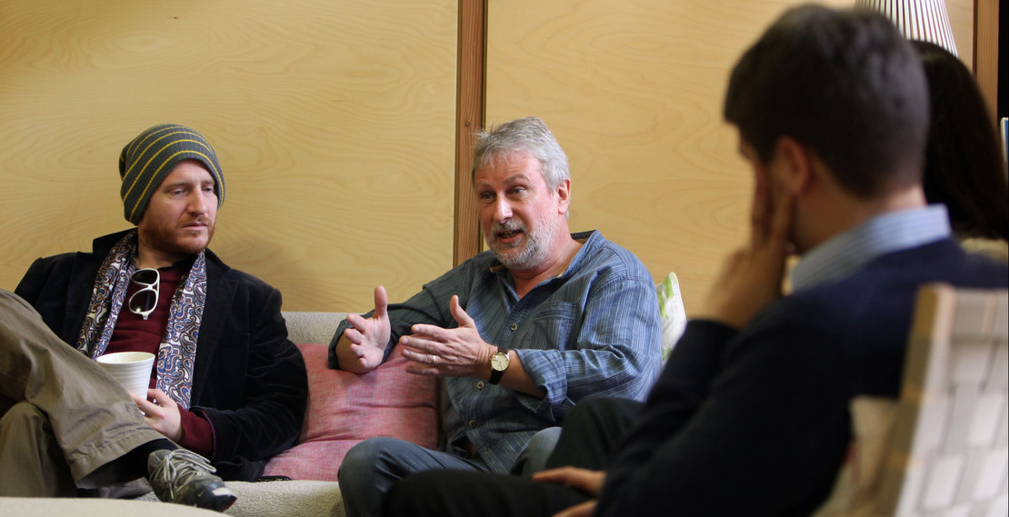
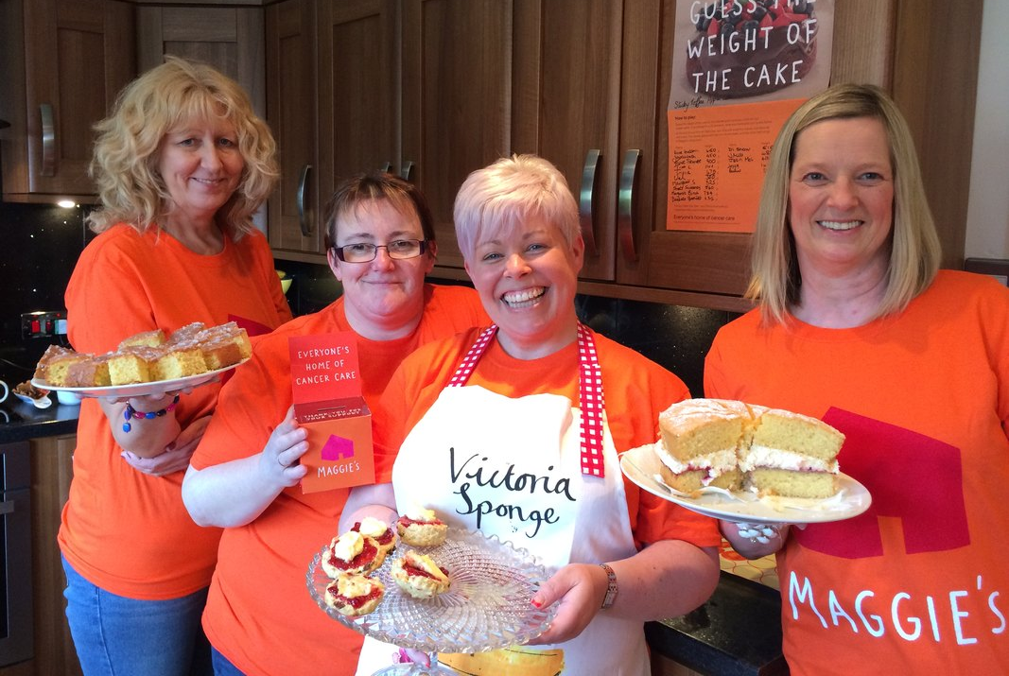
Programme and Fundraising; a remarkable partnership
Part of what makes Maggie’s so special is the connection between programme and fundraising
Centre fundraisers work from the centre they raise funds for, which means they have an invaluable link to the area they are based in. They get to meet with centre visitors and volunteers and develop a real understanding of how vital Maggie’s is for people with cancer, their families and friends.
Our programme staff support centre fundraisers to promote Maggie’s to neighbouring businesses, individuals, community groups, volunteers and media contacts. It broadens their knowledge of how Maggie’s is funded and means they spot more opportunities for fundraising collaborations.
At all levels and across all areas of the organisation our staff work together and take an active part in achieving our goals.
We recognise that all staff have an important part to play in our success regardless of location or role.
"I have never had a job with such variety; every day brings a new and exciting challenge and I’m enjoying it so much." Sam, PR Manager

